Slide 1
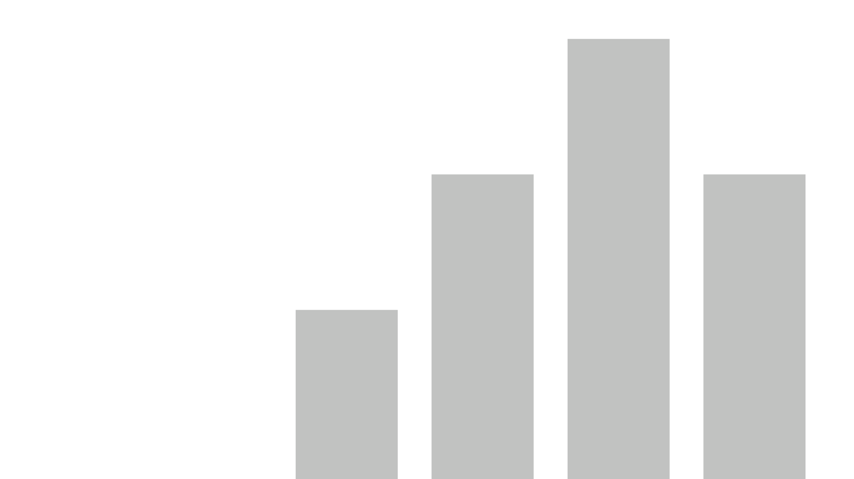


Hostel_What Japanese City Is The Best Bang For Your Buck
View in Power BI
Last data refresh:
11/28/2022 6:40:55 PM UTC
Downloaded at:
11/29/2022 7:38:06 PM UTC

Slide 2
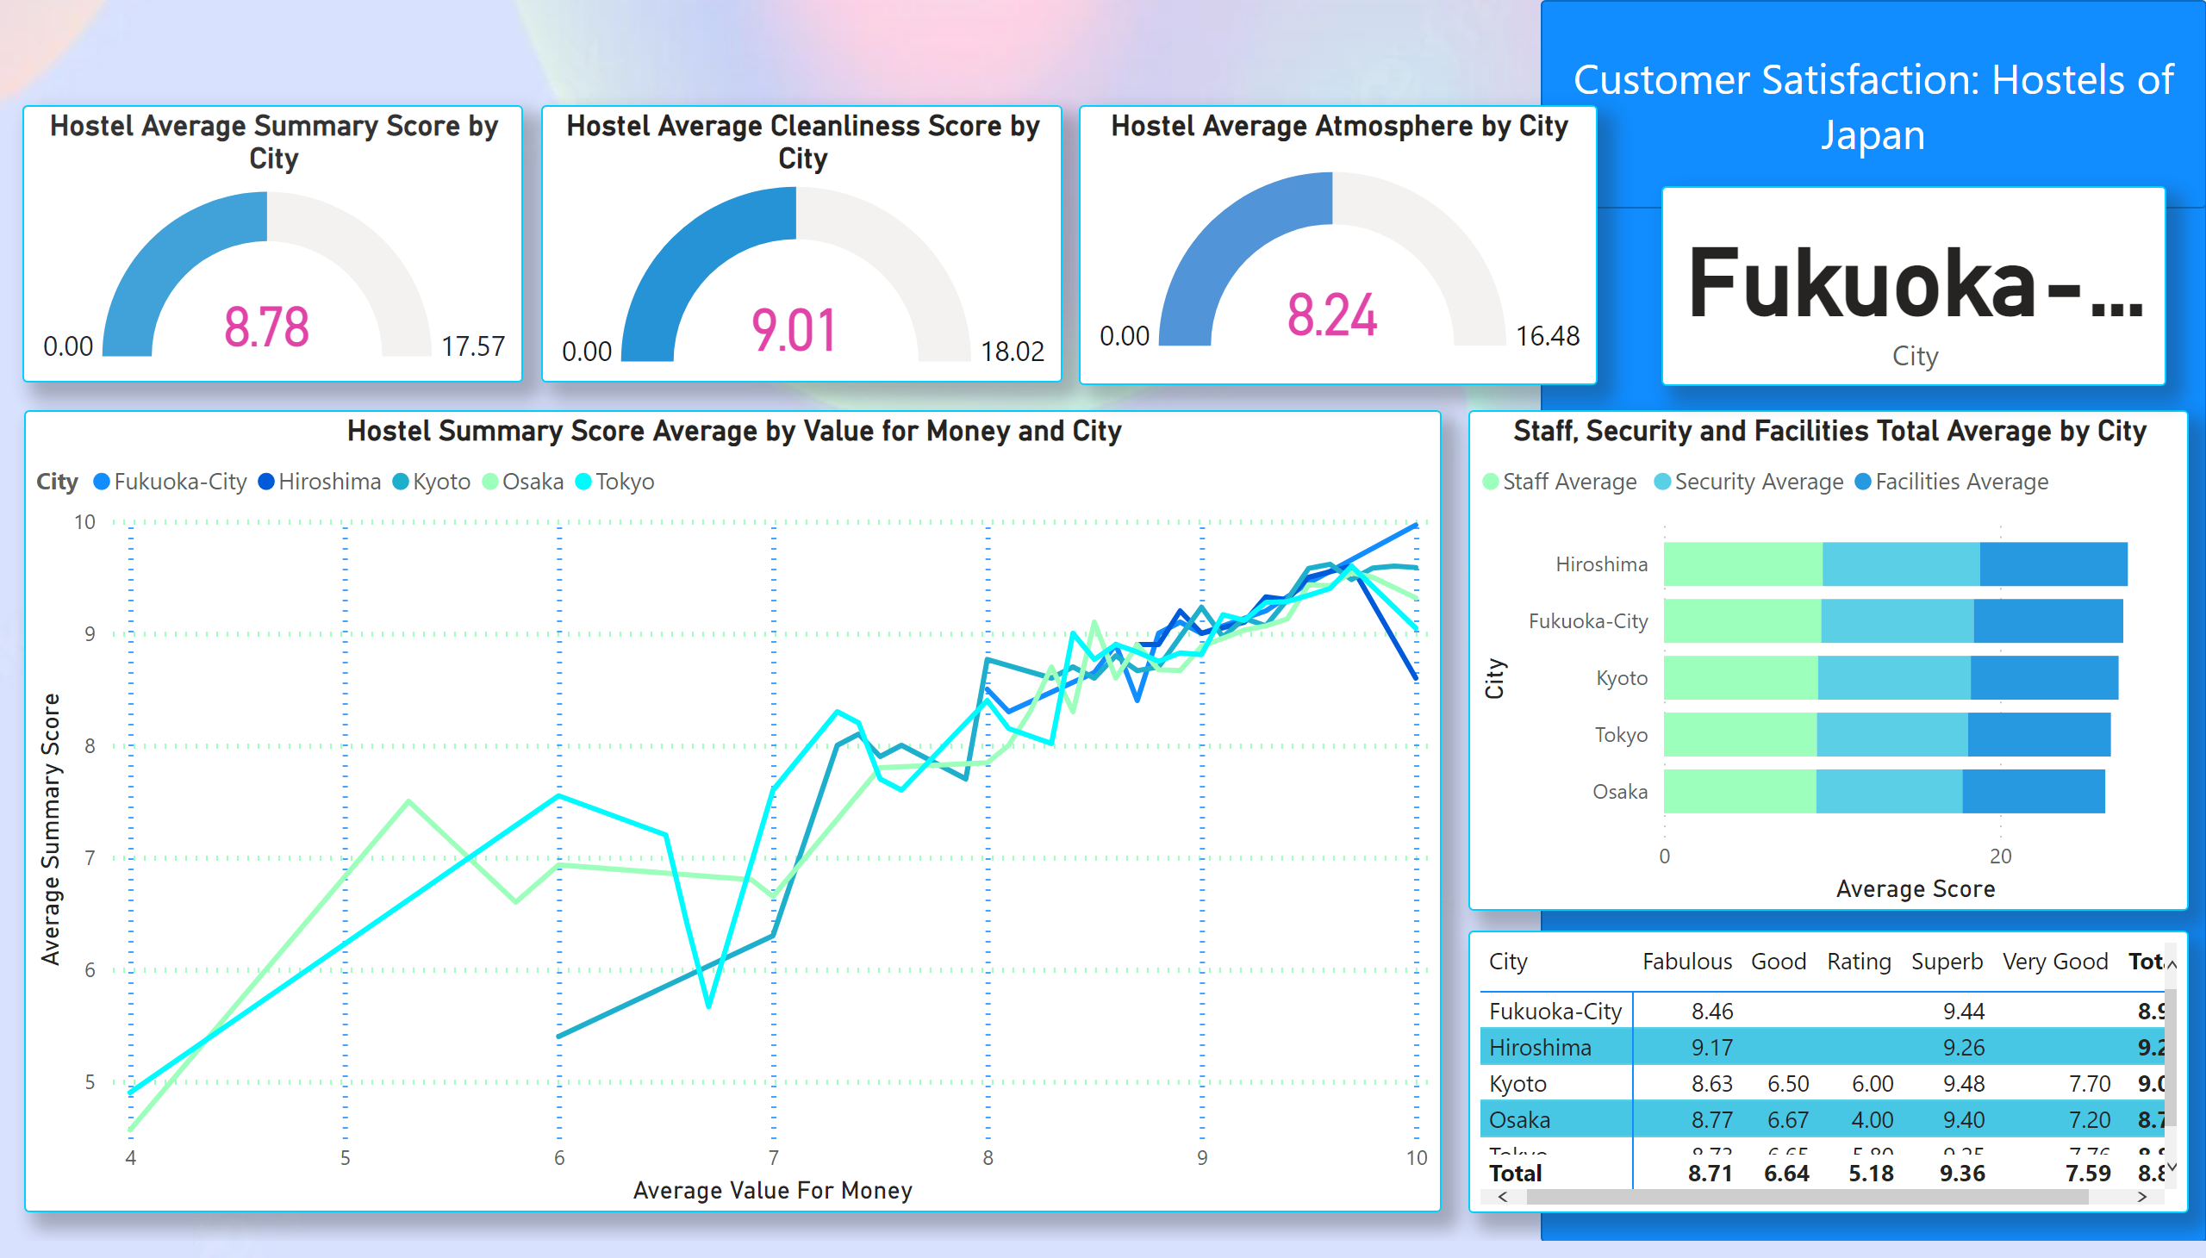
Which Japanese City Should You Visit?
Notes:
card
No alt text provided
pivotTable
No alt text provided
Staff, Security and Facilities Total Average by City
No alt text provided
Hostel Summary Score Average by Value for Money and City
No alt text provided
Hostel Average Summary Score by City
No alt text provided
Hostel Average Cleanliness Score by City
No alt text provided
Hostel Average Atmosphere by City
No alt text provided
shape
No alt text provided
shape
No alt text provided
shape
No alt text provided
shape
No alt text provided

Slide 3
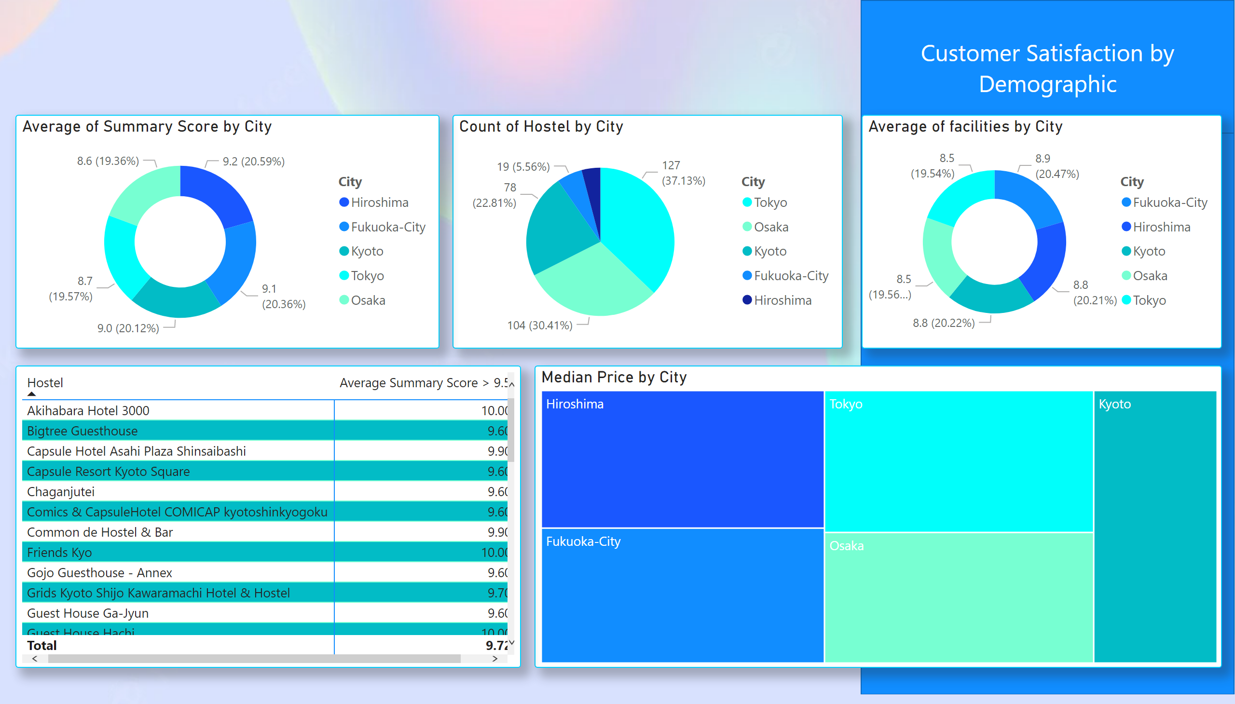
Customer Satisfaction
Notes:
donutChart
No alt text provided
pieChart
No alt text provided
treemap
No alt text provided
donutChart
No alt text provided
pivotTable
No alt text provided
shape
No alt text provided
shape
No alt text provided
shape
No alt text provided
shape
No alt text provided

